Slide 1
Social Media Analytics
Topic 9: Online Reputation Management – Discovering and Inspiring Brand Evangelists

Slide 2
Learning Objectives
Hierarchy of Needs for brand evangelists
Discovering them online
Recognizing True influence

Slide 3

Brand Evangelists
People who
Consistently share your blog posts
Comment on your updates
Demonstrate they really appreciate your brand

Slide 4
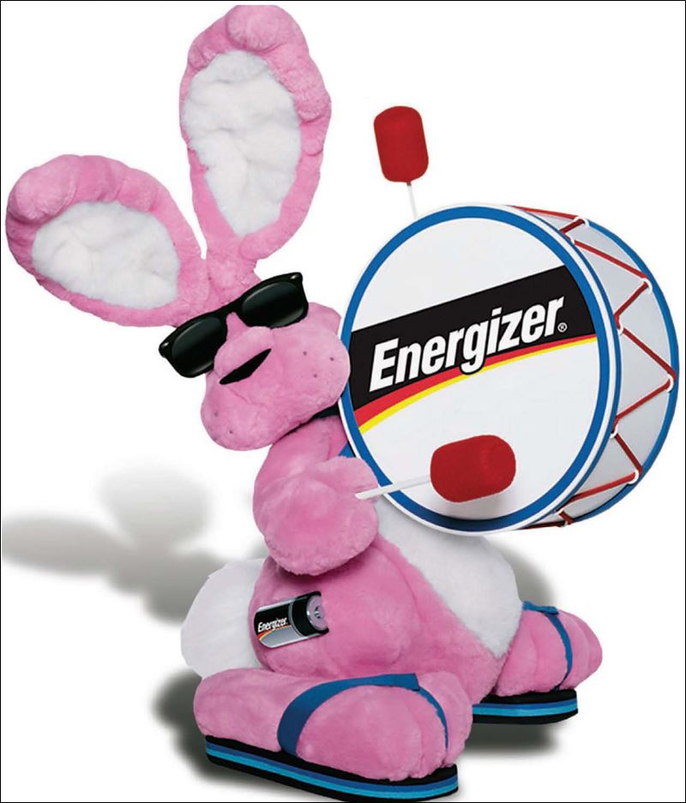
What energizes your brand evangelists?

Slide 5
Hierarchy of Needs for brand evangelists
Recognition
Involvement
Belonging
Trust
Knowledge

Slide 6

Knowledge
Provide quality information specially tailored to audience
Give your brand ambassadors something unique, powerful and meaningful to become experts

Slide 7
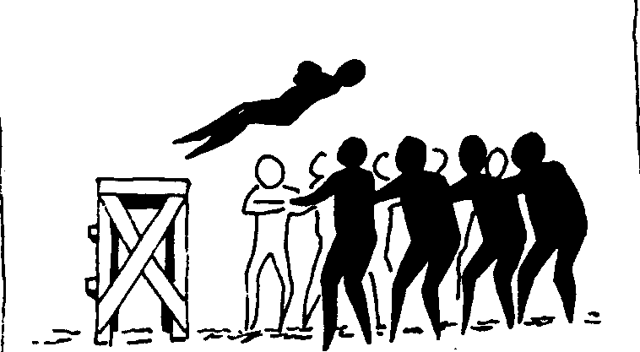
Trust
Can trust your product or services
Foster the trust by being
Reliable
Consistent
E.g. Blog in routine schedule
Stable
Clarify your message and stick with it
Predictable
Evolvement throughout the years while still maintain it essential uniqueness

Slide 8
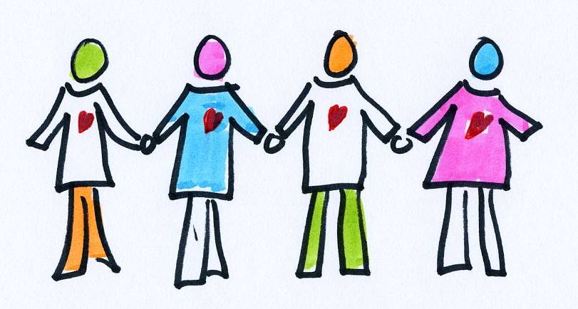
Belonging
Create a sense of community where people belong
Share common interest or passion

Slide 9

Involvement
Desire to develop more relationship
Don’t need bribes or gimmicks
Foster relationships by listening to these people
Acknowledge them privately
Express genuine appreciation
Give them recognition to create and maintain a strong reputation
Give them a story that’s engaging and easy to share

Slide 10

Recognition
Identifying and linking to them in blog posts
Sending them an occasional personalized message or tweet
Commenting on their Facebook pages
Naming and linking to them in email newsletters

Slide 11
Recognition
Publishing their reviews of your product/service
Approaching them for advance feedback
Sending them an occasional personalize gift or card

Slide 12
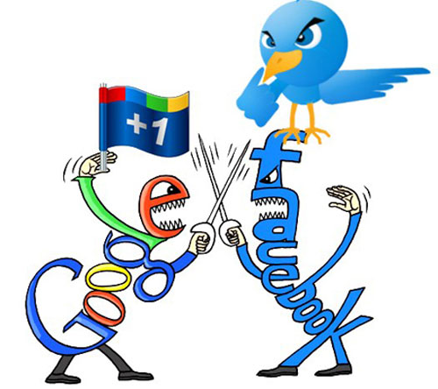
Discovering them online
Brand evangelists like to retweets, blog comments and post directly onto your Facebook page
See them more by setting up listening tools
Check out them on
Blogs
Facebook
Twitter
LinkedIn
Google+

Slide 13
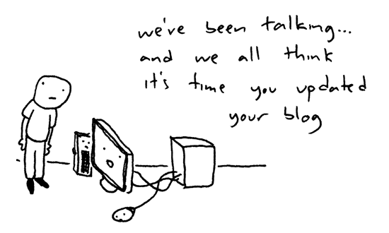
Discovering them online - Blog
Assess them by
How large his number of followers
How much his audience is paying attention to what he says
Number of blog posts
Check if their posts are engaging and interesting
The blogging holy grail involves lots of followers and lots of engagements

Slide 14
Discovering them online - Facebook
Facebook followers, friends, likes, and shares are indicators of interest, influence, and participation
Difference between Facebook profile and Facebook page
More difficult to get people to like a Facebook fan page as it’s a better indicator for genuine interest in that person brand

Slide 15
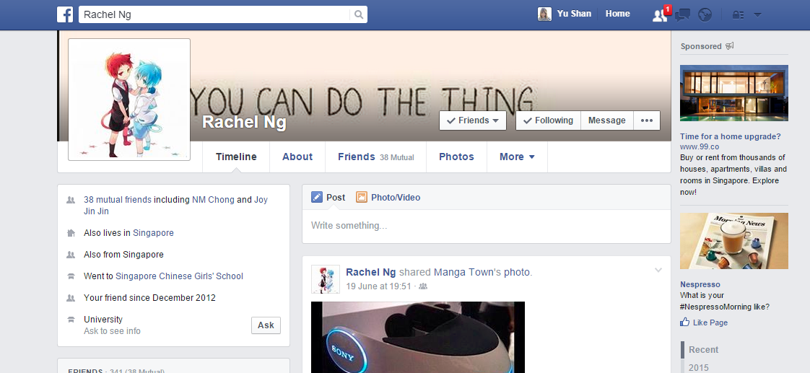
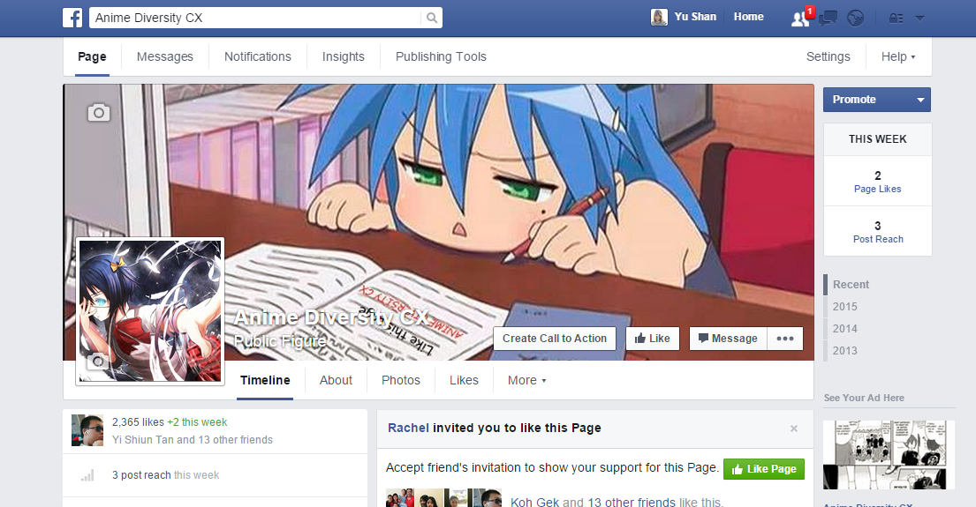
Discovering them online - Facebook
Facebook Profile page
Facebook Fan page

Slide 16

Discovering them online - Twitter
How many followers they have
How often they’re listed
What kinds of list they appear on
How often they’re retweeted
What categories get retweeted most
If they are regularly participate in tweet chat and in which category

Slide 17

Discovering them online - LinkedIn
Check your brand evangelist LinkedIn profile carefully
Is it completely filled out, their work history and education.
Any testimonials
Number of followers may not be important
Pay attention to quality than quantity

Slide 18

Discovering them online – Google+
Google their name and check out her profile
See how much feedback one’s getting on the posts
Google+ tools to take a closer look at the influence:
SocialStatistics
CircleCount
FindPeopleOnPlus

Slide 19

Recognizing True influence
Speaking at conferences
Check if this person speak at any conferences within past year or two
Pay attention to the venues
Look at the kind of conference he is addressing

Slide 20

Recognizing True influence
Authoring books
Check if this person authored any books
Some of the influential authoring categories include
White papers
Podcasts
Video series

Slide 21

Recognizing True influence
Participating in groups and forums
Lists in a number of professional organization related to your brand, group or local meet-up group
How active is the person in the group
Take note of active, insightful forums such as Wikis community users

Slide 22

Recognizing True influence
Rating Influence
Check them online using the following tools
Followerwonk
Klout
Traackr
eCairn
PeekYou

Slide 23
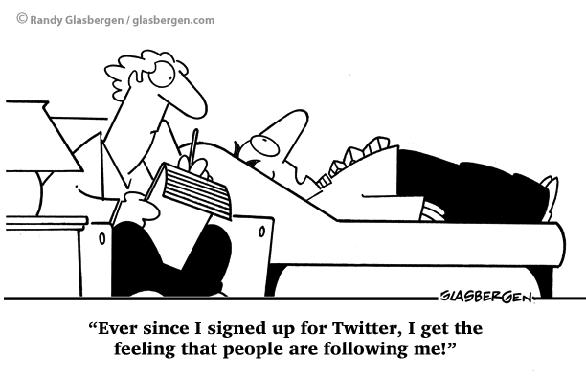
Youtube: The four rules of Influencer marketing by mBlast

